Slide 1

BANK ANALYTICS (Data analyst project)
the Methodology of the data to extract meaningful financial insights

Slide 2
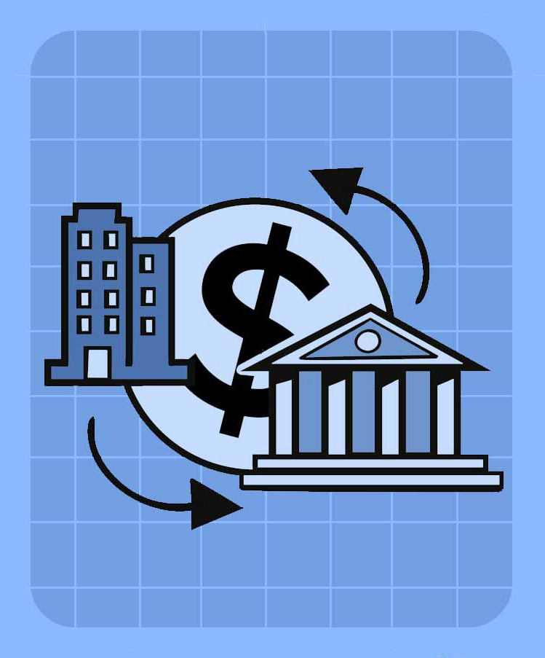
INTRODUCTION
Effective decision-making in banking is becoming increasingly dependent on intelligent data analysis. This Project focuses on the optimization of bank loan operations through the use of customer data. The project uses tools like Excel, Power BI, Tableau, and MySQL to analyze finance data from bank loan customers, reduce operations, and ultimately improve the entire customer experience. Through the reports, I want to empower financial institutions with actionable information, enabling efficiency and creativity in the ever-changing world of banking services.

Slide 3
Tools behind Project
A timeline of the actions leading up to the famous event
EXCEL
POWER BI
TABLEAU
SQL

Slide 4

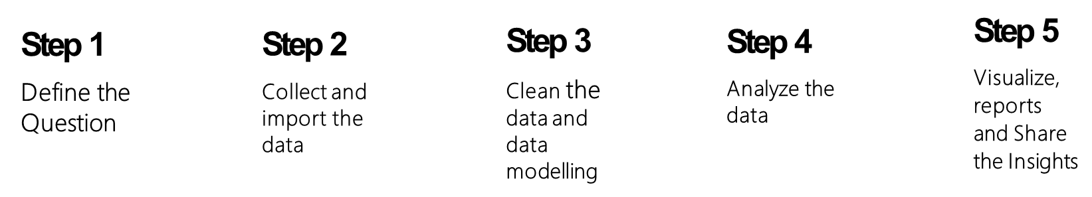
A Roadmap to Effective Analysis

Slide 5
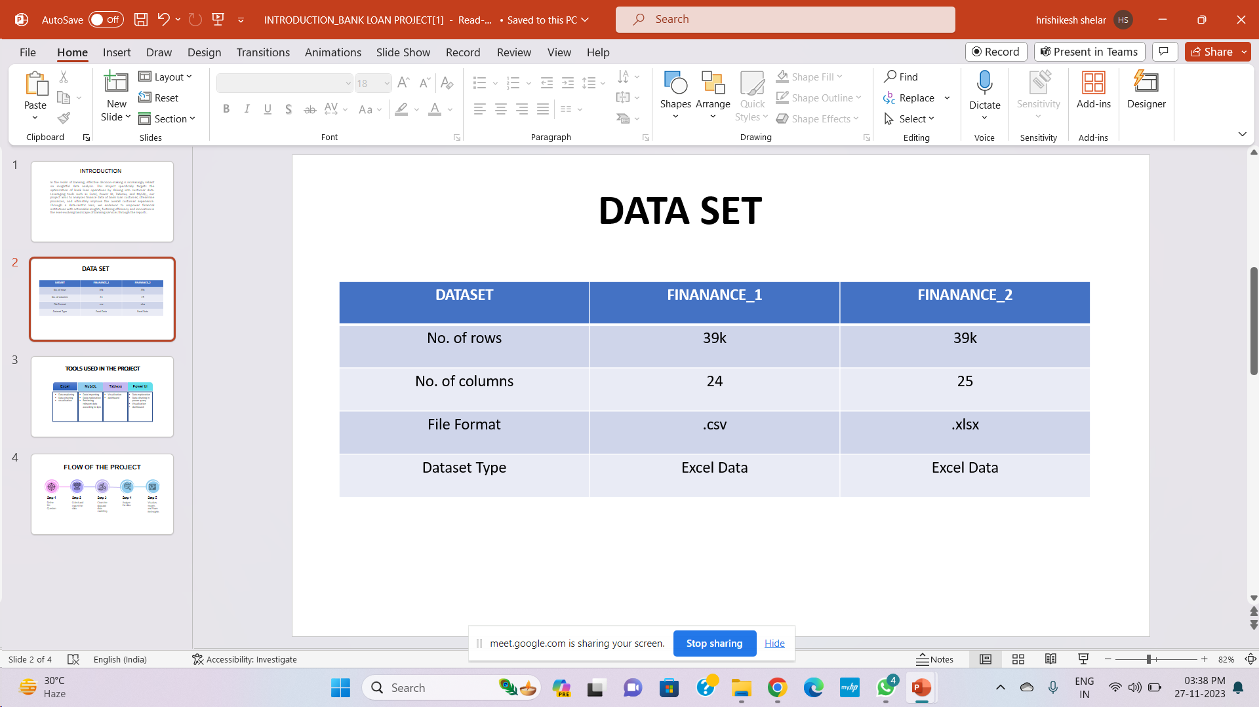
Data overview

Slide 6
KPI – 1 Year Wise Loan Amount Stats
Overall, there is an upward tendency in the loan amount; it peaked in 2009 and increased significantly in 2010 and 2011, which may be a reflection of changes in lending practices and the state of the economy at the time.

Slide 7
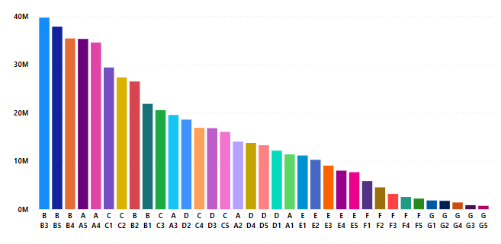
Kpi-2 Grade And Sub-Grade wise Revolving Balance
Most revolving balances are found in Grade B, especially in B3. Decreasing tendency Down Grades: From higher to lower grades (A to G), rotating balances exhibit a falling tendency.

Slide 8

Verified vs non-verified status Payments
The total payment for verified account is higher as compared to non-verified.
There are 59% verified accounts and remaining 41% are non-verified.

Slide 9
Homeownership vs Last payment date
The number of individuals living in various sorts of arrangements is displayed in a bar graph between 2007 and 2016. Between 2010 and 2013, there was a notable rise in the proportion of those renting and owning mortgages, and then a noteworthy fall. According to the data, the proportion of homeowners has stayed largely constant throughout time.

Slide 10
Year wise collection recovery
The graph shows a significant increase in the collection recovery fee from 2007 to 2011. The data points are marked for each year, showing an upward trend in the collection recovery fee.

Slide 11
Year wise funded_amt and funded_amnt_inv
The image shows a bar graph representing the sum of “funded_amnt” and “funded_amnt_inv” from the years 2007 to 2011. There is a significant increase in both “funded_amnt” and “funded_amnt_inv” over these years, with the most notable jump occurring from 2009 to 2010

Slide 12
Loan status of funded amount
The pie chart shows that 81% of the loans have been fully paid, 15% have been charged off, and 4% are currently ongoing. The majority of the loans have been fully paid, which is a positive sign. However, the percentage of charged off loans is also significant, indicating that some borrowers have defaulted on their loans.

Slide 13
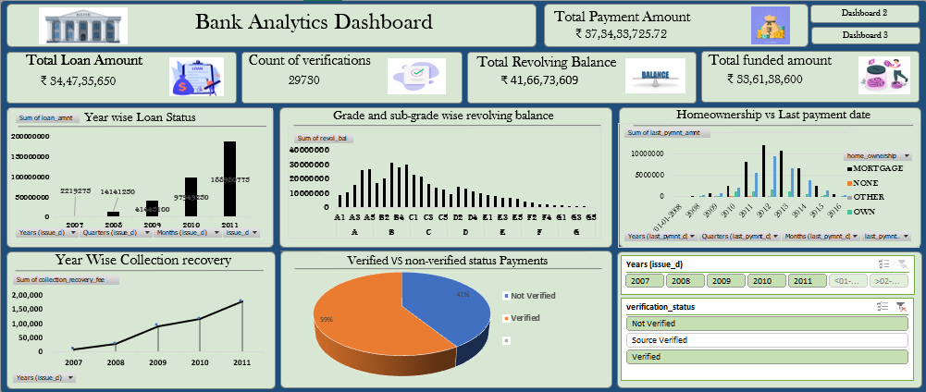
Excel Dashboard

Slide 14
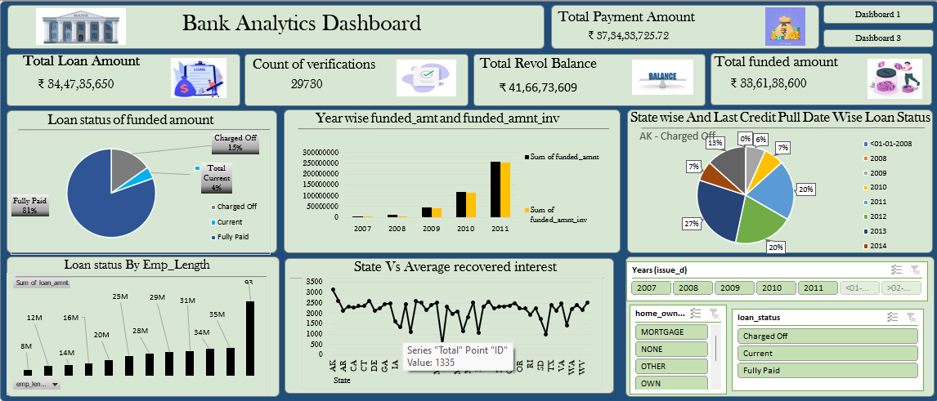
Excel Dashboard

Slide 15
Key Insights
The data indicates a consistent and substantial increase in the loan amounts from 2007 to 2011.
The total loan amount grew from 2007 to 2011, representing a significant expansion.
The data is categorized from A to G, representing different levels of revolving balances. Categories B and C have the highest revolving balances, respectively .suggesting that a significant portion of the overall revolving balance is concentrated in these groups.

Slide 16
Key Insights
The higher percentage associated with "Verified" transactions suggests that a significant portion of the total payments comes from transactions that have undergone some form of verification.
This suggests that when transactions are verified, they could involve bigger or more dependable payments. If there are more verified payments, it might mean that the risk of fraud is being handled well. The data could show that people using the service are okay with doing the verification process because they trust the service

Slide 17
Challenge Faced during project
"When i were doing the project, one big problem i had was that there was a lot of information to look at. Understanding and working with a large amount of data was tough at the beginning of the project."

Slide 18
Conclusion
In simple words, the project carefully looked at a lot of information about loans. This helped the financial institution understand important things for its long-term growth. By studying where loans are, finding out what might be risky, and looking closely at how people make payments, the institution learned a lot about its different loans. This information is like a base for improving how they give out credit, lowering risks, and making customers' experiences better.

Slide 19
THANK YOU……

